Slide 1
Mobile Platform Localization II
Lecture 10-1
RBE500-F17
Adj. Prof. Julian Center

Slide 2
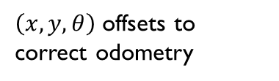
Continuous Localization and Mapping
Time
Local Map
Global Map
Matching
Registration
$\left(x,y,θ\right)$ offsets to correct odometry

Slide 3
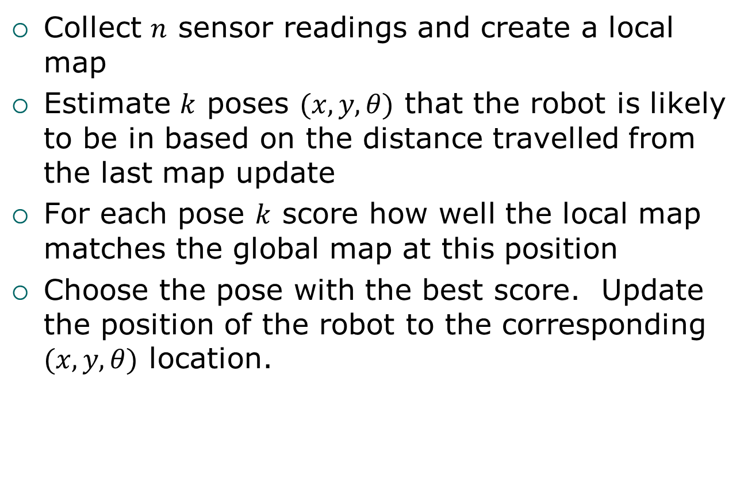
Matching and Registration
Collect $n$ sensor readings and create a local map
Estimate $k$ poses $(x,y,θ)$ that the robot is likely to be in based on the distance travelled from the last map update
For each pose $k$ score how well the local map matches the global map at this position
Choose the pose with the best score. Update the position of the robot to the corresponding $(x,y,θ)$ location.

Slide 4
Reducing Complexity
In an attempt to reduce the potential size of the search space, different representations of the world may be applied.
For example, one simplification might be to incorporate discrete objects into a representation that “includes” obstacles into the map.

Slide 5
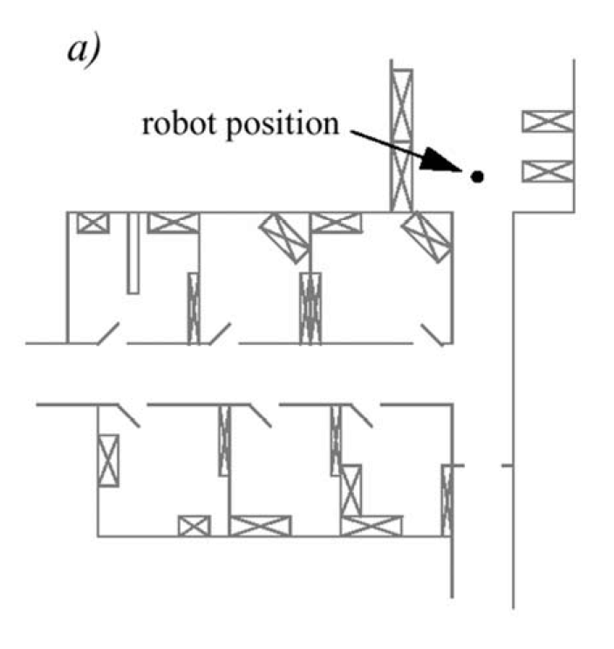
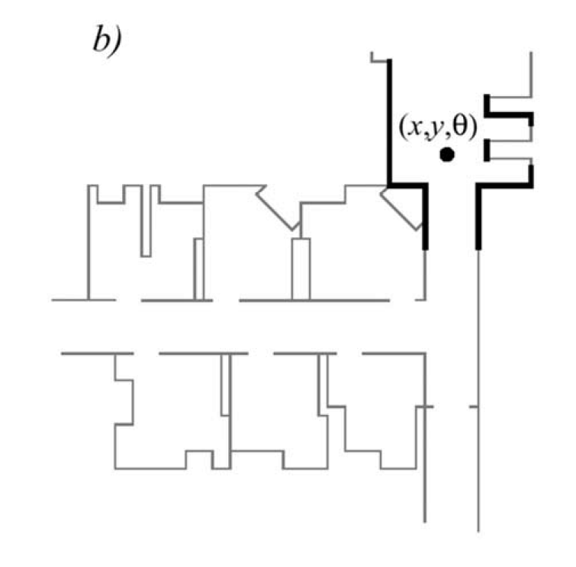
Representations
The real map with walls, doors and furniture.
Line-based map (~100 lines)

Slide 6
Feature-Based Localization
Another approach might be to not map the layout of the space, but rather to connect identifiable features in the environment as a connected graph.
This might not be as “human friendly” but may allow for sufficient localization.

Slide 7
Feature-Based Localization
Extract features such as doorways, corners and intersections
Based on detecting these features:
Use continuous localization to try and match features at each update
Use topological information to create a graph of the environment

Slide 8
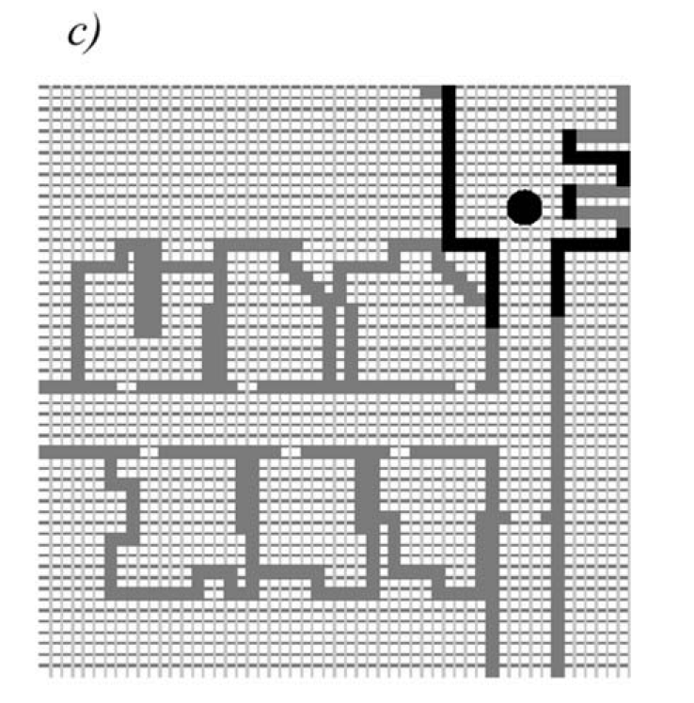
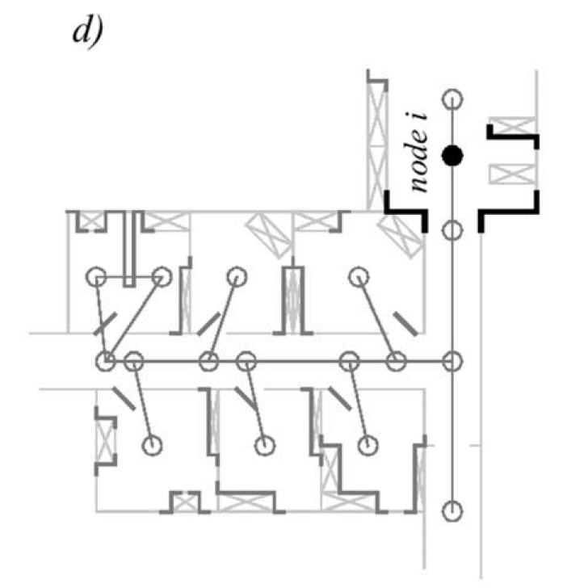
Representations
Grid-based map (3000 cells, each 50cm x 50cm)
Topological map (50 features, 18 nodes)

Slide 9
Enter Uncertainty
When using real sensor data, it is unlikely that the world and the measurements will match exactly.
In fact, there may be multiple localization solutions that are more-or-less equally good.
Optimizing the fit (and thus localizing) effectively increases the probability we’re correct.

Slide 10
Localizing
However, the optimal fit might still be wrong.
Typically you’ll want to preserve multiple potential solutions.
As the robot moves in the world, one of those lower probability solutions may begin to increase in probability.
Each solution represents a relative amount of belief in that candidate solution.

Slide 11
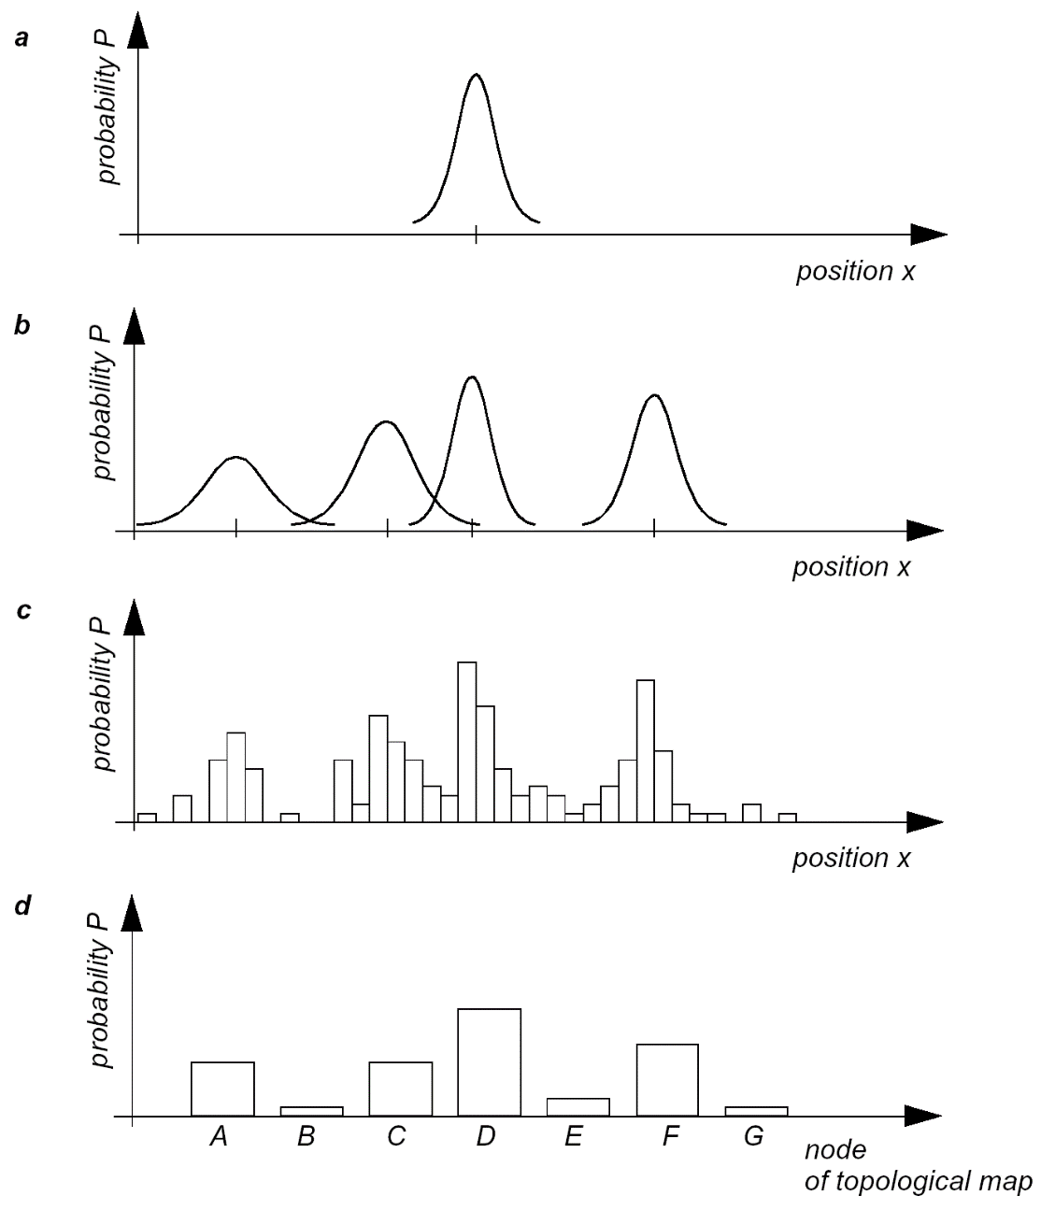
Belief representation
a) Continuous map with single hypothesis probability distribution
b) Continuous map with multiple hypotheses probability distribution
c) Discretized map with probability distribution
d) Discretized topological map with probability distribution

Slide 12
Belief representation
Single-hypothesis belief
The robot’s belief about it’s position is expressed as a single point on a map
Advantage: no ambiguity, simplifies planning and decision making
Disadvantage: does not represent ambiguity/uncertainty
Multi-hypothesis belief methods allow the robot to track (possibly infinitely) many possible positions.

Slide 13
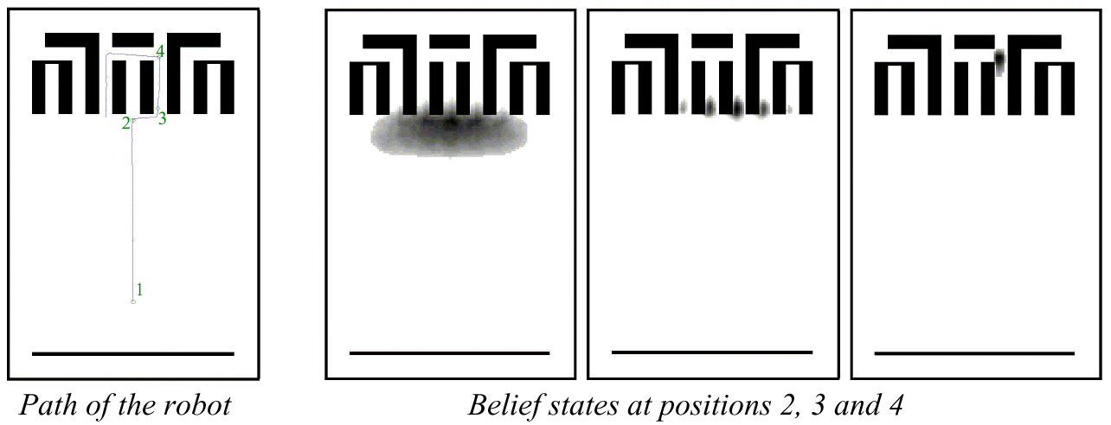
Multi-hypothesis belief tracking example

Slide 14
Kalman Filtering
Generally used for tracking a single hypothesis.
Multiple hypotheses are tracked by instantiating multiple KFs.
Each filter attempts to determine an optimal estimate.
Decisions about multiple estimates are performed at a higher level.

Slide 15
The Basic Idea
What we’d like to do is make a sensor measurement, make a movement, and then optimally combine the data.
Sense
Move

Slide 16




















What we want to represent
$$x_{k}$$
$$x_{k−1}$$
$${\overline{z}}_{k}$$
$${\overline{x}}_{k}$$
$$u$$
Prior Position Estimate – Where do think I was last?
Movement Estimate – Based on my inputs, where did I go?
Measurement Estimate – What are my sensors now telling me?
New Estimate – What’s the best estimate of my location now?
Once x_{k} is calculated, that value is assigned to x_{k-1} and the
process begins again.
$$x_{k}$$
$$x_{k}$$
$$x_{k}$$
$$x_{k−1}$$
$$x_{k−1}$$
$$x_{k−1}$$
$${\overline{z}}_{k}$$
$${\overline{z}}_{k}$$
$${\overline{z}}_{k}$$
$${\overline{x}}_{k}$$
$${\overline{x}}_{k}$$
$${\overline{x}}_{k}$$
$$u$$
$$u$$
$$u$$

Slide 17
What is a Kalman Filter?
A Kalman Filter is a particular form of an optimal estimator.
A KF is a recursive filter, meaning that new measurements are processed as they arrive.
This means that a KF may allow producing optimal estimates in real-time.

Slide 18
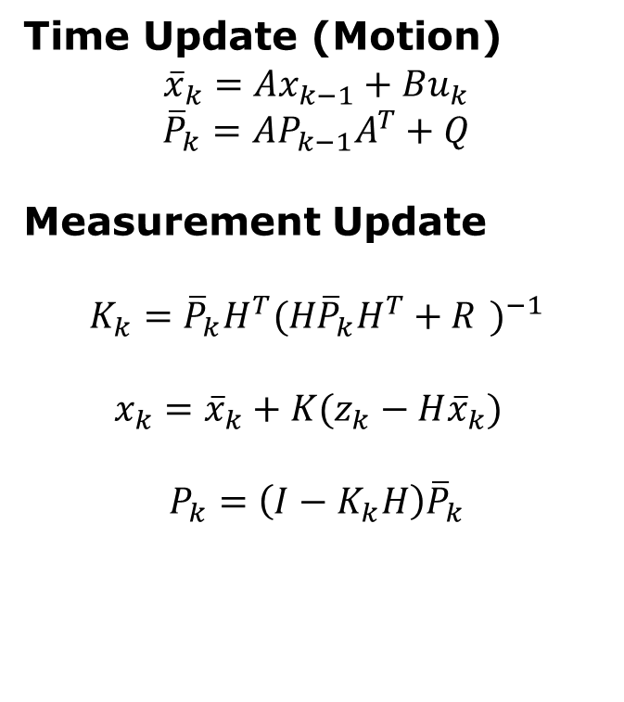
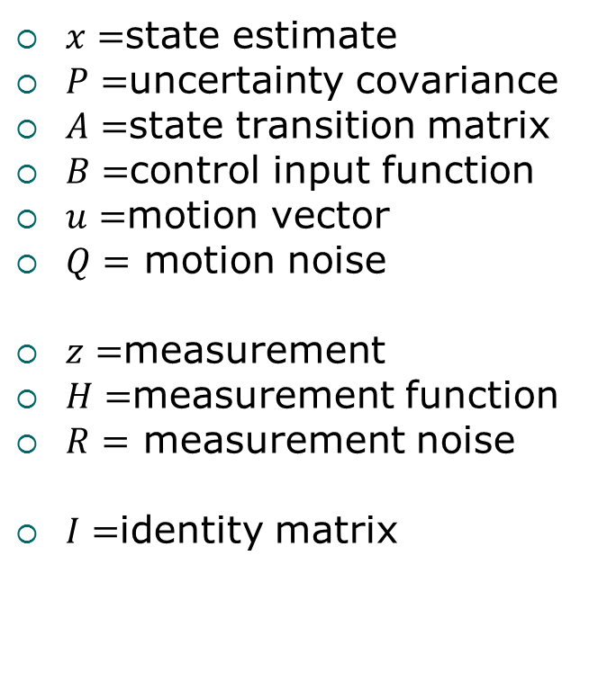
Kalman Filter at a Glance
$x=$state estimate
$P=$uncertainty covariance
$A=$state transition matrix
$B=$control input function
$u=$motion vector
$Q=$ motion noise
$z=$measurement
$H=$measurement function
$R=$ measurement noise
$I=$identity matrix
Time Update (Motion)
$${\overline{x}}_{k}=Ax_{k−1}+Bu_{k}$$
$${\overline{P}}_{k}=AP_{k−1}A^{T}+Q$$
Measurement Update
$$K_{k}={\overline{P}}_{k}H^{T}{(H{\overline{P}}_{k}H^{T}+R )}^{−1}$$
$$x_{k}={\overline{x}}_{k}+K(z_{k}−H{\overline{x}}_{k})$$
$$P_{k}=\left(I−K_{k}H\right){\overline{P}}_{k}$$

Slide 19
Characteristics of the KF
In the case of Gaussian noise:
Given the mean and standard deviation of the noise, the KF will minimize the MSE of the parameters being estimated.
For non-Gaussian noise:
The KF will still produce the best (MSE) error based on the assumption that the dynamics are linear.

Slide 20
KF and Non-Linear Noise Processes
All is not lost:
A KF forms the optimal linear estimate of state.
If noise is not Gaussian, it may be possible to “whiten” it by passing through a filter to modify its power spectral density.
There are also non-linear variants of the KF (specifically the EKF and UKF).
Or other non-linear estimators.

Slide 21
Example KF Problem
We will assume a discrete time system of the form:
This state equation captures the evolution of state with time (k=0, 1,…,n)
v(k) represents process noise n the system
$$x\left(k+1\right)=F\left(k\right)x\left(k\right)+G\left(k\right)u\left(k\right)+v(k)$$

Slide 22
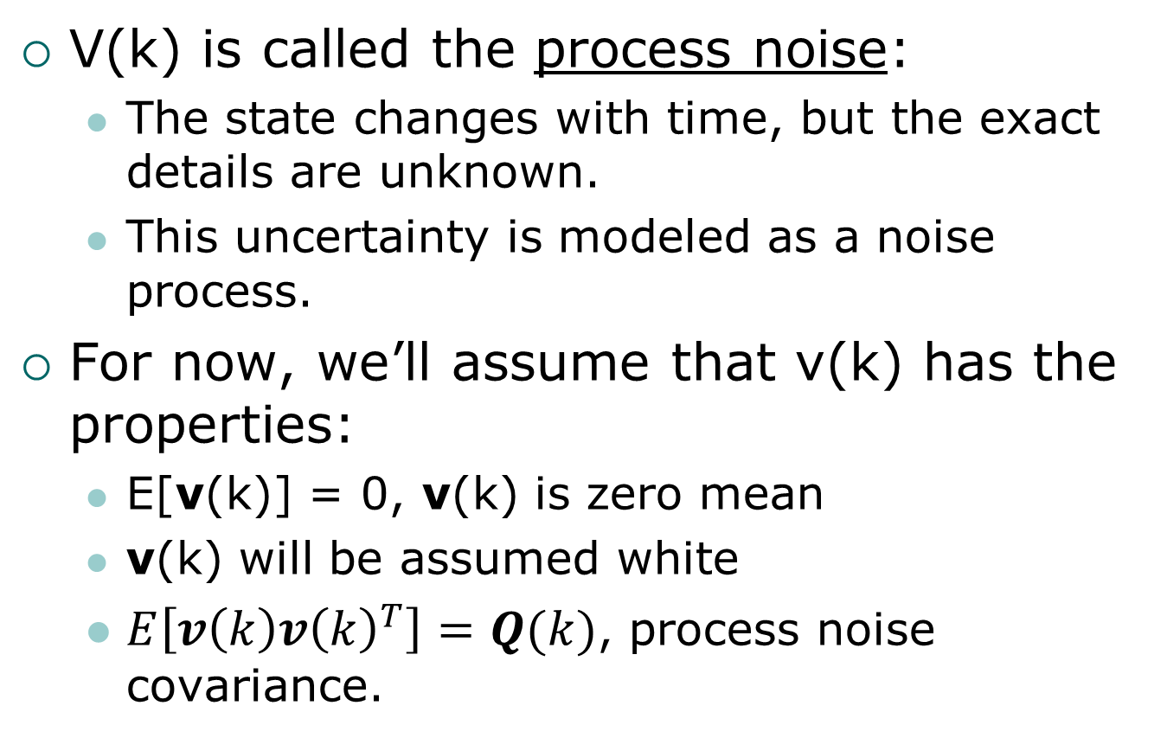
Noise Characteristics
V(k) is called the process noise:
The state changes with time, but the exact details are unknown.
This uncertainty is modeled as a noise process.
For now, we’ll assume that v(k) has the properties:
E[v(k)] = 0, v(k) is zero mean
v(k) will be assumed white
$E\left[v\left(k\right){v\left(k\right)}^{T}\right]=Q(k)$, process noise covariance.

Slide 23

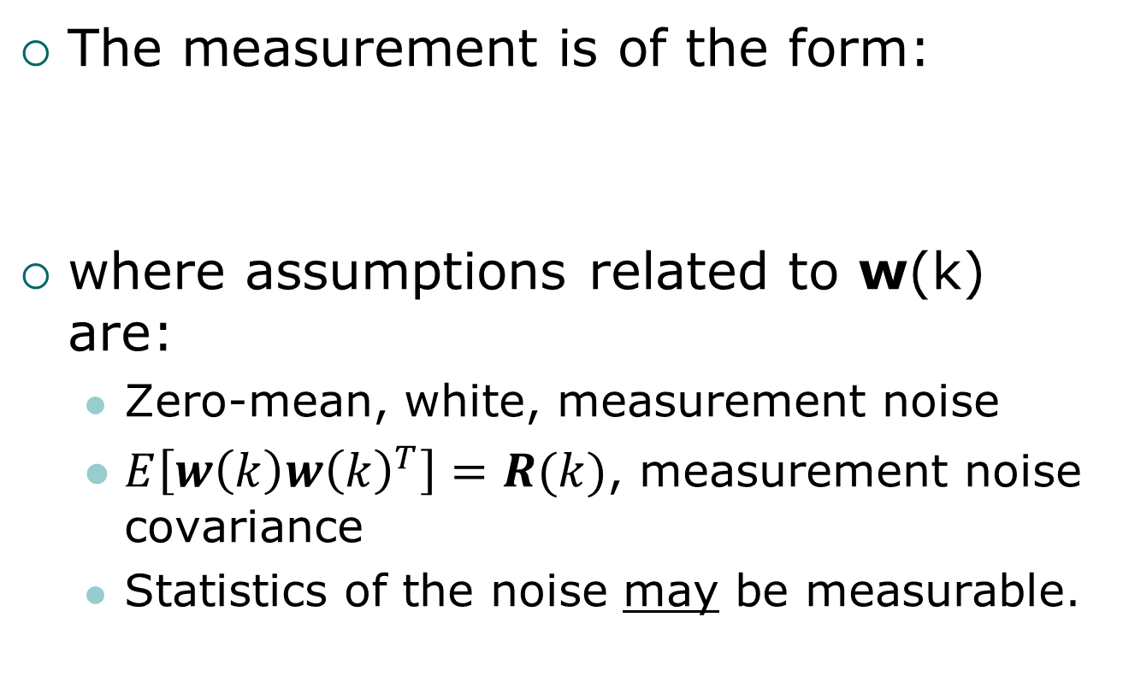
The Measurement Equation
The measurement is of the form:
where assumptions related to w(k) are:
Zero-mean, white, measurement noise
$E\left[w\left(k\right){w\left(k\right)}^{T}\right]=R(k)$, measurement noise covariance
Statistics of the noise may be measurable.
$$z\left(k\right)=H\left(k\right)x\left(k\right)+w(k)$$

Slide 24


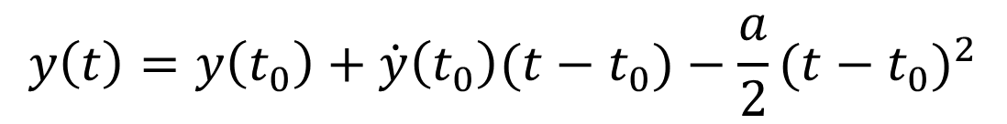
A Simple Example
F = Ma – A simple mass falling under the influence of gravity.
Estimate its next location based on noisy position measurements.
Assuming a scalar system and a 1kg mass, our continuous measurement equation is:
$$\ddot{y}\left(t\right)=−a(t)$$
$$\dot{y}(t)=\dot{y}\left(t_{0}\right)−a(t−t_{0})$$
$$y\left(t\right)=y\left(t_{0}\right)+\dot{y}\left(t_{0}\right)(t−t_{0})−\frac{a}{2}{(t−t_{0})}^{2}$$

Slide 25
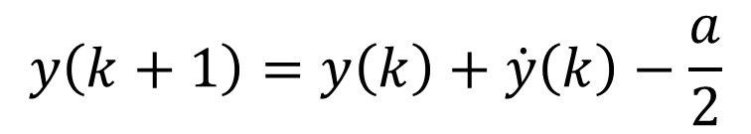
Discretizing Our Equation
Assume that our time steps are in quanta of 1. i.e. t – t₀ = 1.
According to the previous equation, location relies on the prior position and prior velocity.
In discrete time:
$$y\left(k+1\right)=y\left(k\right)+\dot{y}\left(k\right)−\frac{a}{2}$$

Slide 26
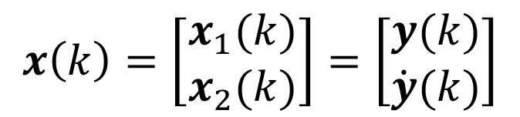
Defining System State
We now need to assign meanings for the state variables of our system.
In this case it is position and velocity that are variable. Let’s define the state variable, x, as:
$$x\left(k\right)=\left[\begin{matrix}x_{1}(k) \\ x_{2}(k)\end{matrix}\right]=\left[\begin{matrix}y(k) \\ \dot{y}(k)\end{matrix}\right]$$

Slide 27
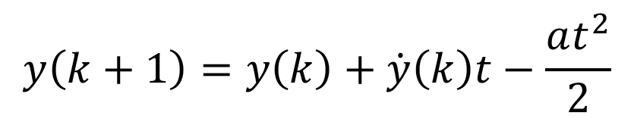

Our State Equation
In general:
Expressing position and velocity in discrete time:
and
$$x\left(k+1\right)=F\left(k\right)x\left(k\right)+G\left(k\right)u\left(k\right)+v(k)$$
$$y\left(k+1\right)=y\left(k\right)+\dot{y}\left(k\right)t−\frac{at^{2}}{2}$$
$$\dot{y}\left(k+1\right)=\dot{y}\left(k\right)−at$$

Slide 28

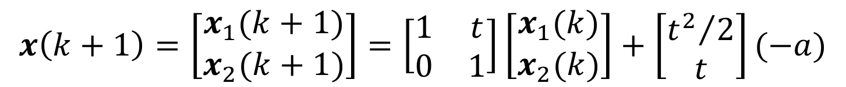
Substituting Variables
Substituting our state variable definitions yields:
Note:
Input drive is gravitational acceleration
Assumed no process noise
$$x\left(k+1\right)=\left[\begin{matrix}x_{1}(k+1) \\ x_{2}(k+1)\end{matrix}\right]=\left[\begin{matrix}1 & t \\ 0 & 1\end{matrix}\right]\left[\begin{matrix}x_{1}(k) \\ x_{2}(k)\end{matrix}\right]+\left[\begin{matrix}{t^{2}}/2 \\ t\end{matrix}\right](−a)$$
$$=Fx\left(k\right)+Gu$$

Slide 29


Our Measurement?
In this example we are receiving noisy measurements of position.
So the measurement equation is:
Remember:
The x₁ state element = position, y(k).
We need the variance of w(k) to implement the KF.
$$z\left(k\right)=Hx\left(k\right)+w(k)$$
$$=\left[\begin{matrix}1 & 0\end{matrix}\right]x\left(k\right)+w(k)$$

